Slide 1
Welcome To The Family
Sanborn Regional HS
Class of 2023
Please type the address below and sign up for our weekly newsletter
(It’s fun, we promise)
https://bit.ly/2TJYEJS

Slide 2
Welcome Sanborn Regional HS
Class of 2023
Notes:
This is where I can see my notes.

Slide 3
High School Information Night
Welcome 8th grade students and parents!
Brian M. Stack, Principal
Bob Dawson, Assistant Principal/Curriculum
Steve Krzyzanowski, Assistant Principal/FLC
Heidi Leavitt, Director of Guidance
Vicki Parady-Guay, Athletic Director

Slide 4
By the end of tonight, you will….
Be familiar with our school building, our schedule, and some of our classes and teachers.
Understand how the course selection process will take place for your son/daughter.
Be aware of the extra-curricular opportunities and special programs that are open to SRHS students.

Slide 5
The Crew of Misfit Toys

Slide 6
Small Learning Communities at Sanborn: Personalization For Each Student:
Grade 9: The Freshman Learning Community: High School Transition
Grade 10: The Sophomore Experience: Project Based Learning with a community focus
Grades 11-12: Junior/Senior Team: Exploring college and career options

Slide 7
Freshman Learning Community
Supports transition to high school
Teams – Core group of teachers share the same students (English, Social Studies, Science, Math)
Intervention and academic assistance - Focused Learning Time (FLT) & after school tutoring
Enrichment– honors option and FLT choices
Advisory with team teachers

Slide 8
Required Courses (8 credits)
English Literature and Comp.
Global Studies
Physical Science
Wellness (Health & Physical Ed.)
Math
Electives (3 electives)
**World Language (two years are required by most 4 year colleges)

Slide 9
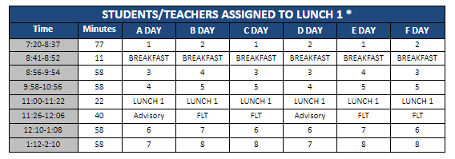

Slide 10
Honors Courses
In 9th Grade at SRHS, Honors classes are optional courses that are available to all students who meet and keep up with the Honors expectations. These requirements are laid out in the course-specific Honors contracts, which have already been made available to students in their regular classes.
Available Honors Courses: English, Global Studies, and Science are offered through the FLC. For Honors Math options, speak to your student’s teacher!
Your student’s teachers can give you more information about Honors options and contracts, stop by and see them or send them an email with any questions.
Notes:
Heather Wheeler

Slide 11
English Literature & Composition

Slide 12
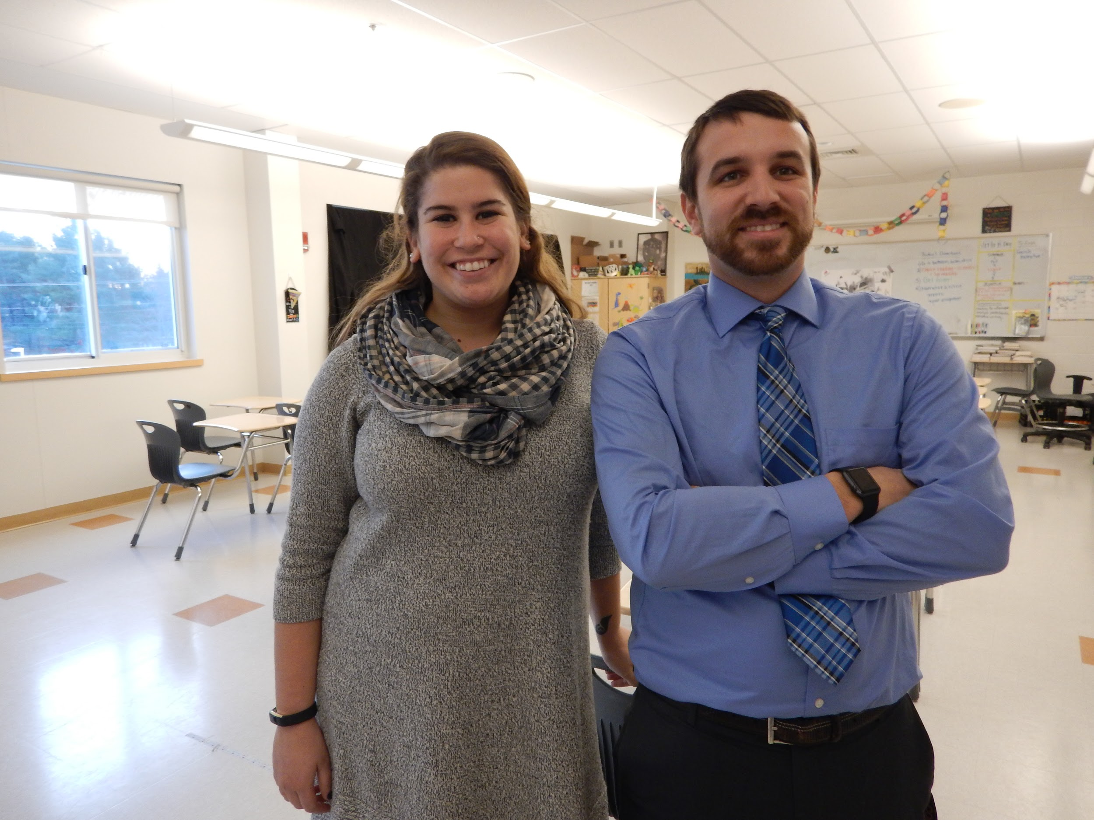
Global Studies

Slide 13
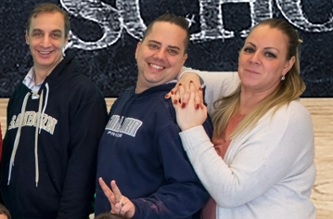
Physical Science

Slide 14
Wellness

Slide 15
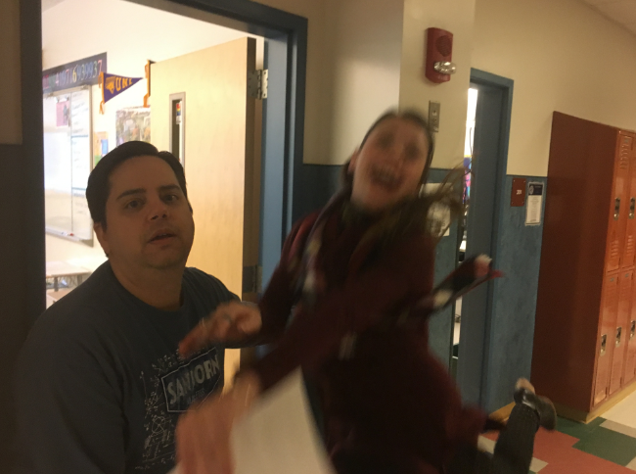
Math

Slide 16
Special Education

Slide 17
Ninth Grade Electives
Automotive
Band
CAD
Ceramics
Chorus
Creating Games and Apps.
History of Rock and Roll
Modern Media
Popular Fiction into Film
Robotics
Technology for the 21st Century
Visual Arts
Woodworking
World Language: French & Spanish

Slide 18
New Hampshire Scholars Program
**Open to all students at SRHS**
Why Join NH Scholars?
90% NH Scholars attend college immediately after high school
61% NH high school seniors attend college immediately after high school
What You Get as a NH Scholar:
Free college applications to 10 New Hampshire institutions
Merit scholarships at various colleges in New Hampshire
At Graduation: Medallion, Gold Seal On Diploma, Noted on Transcript

Slide 19
Focused Learning Time (FLT)
Notes:
Izzy (Isabelle Lang) & Ashley (Felisberto)

Slide 20
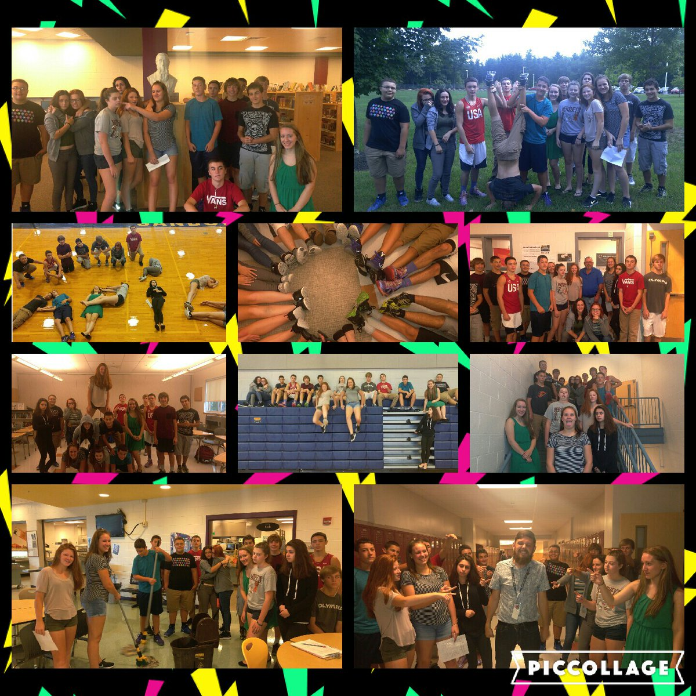
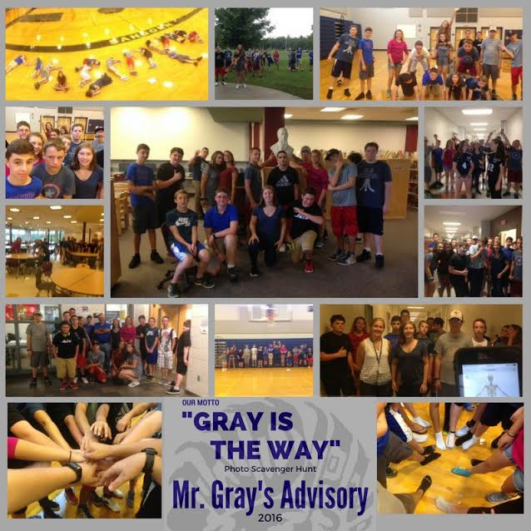
Advisory
Meet once every 3 days
Non-academic setting
Team Building
Organization/Skills
GUTS Program - Students develop Skills to learn from mistakes and grow as learners using the 7 characteristics of Grit: Creativity, Gratitude, Grit, Optimism, Social Intelligence, Zest, Self Control.
Notes:
Brian Gray

Slide 21
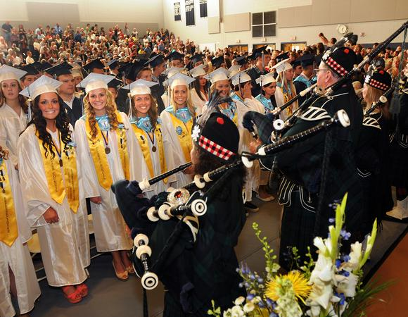
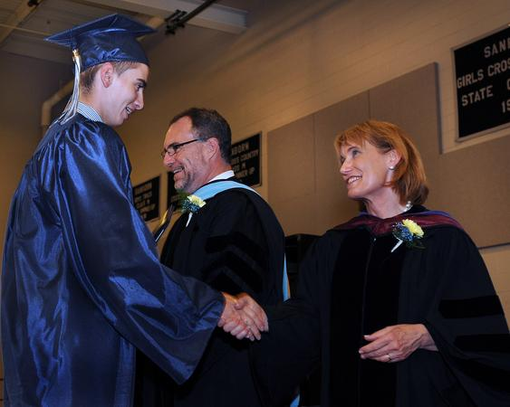
3 Diploma Options For Sanborn Students:
College & Career Diploma: 28 Credits
College & Career Diploma With Distinction: 32 Credits
State of NH Minimum Standards Diploma: 20 Credits (administrative approval required)
Notes:
Michelle Catena, Director of School Counseling

Slide 22
Minimum Schedule Requirements
NH Scholars Program
English – 4 credits
Math – 3 courses (Algebra 1, Geometry, and Algebra 2)
Science – 3 credits (Biology and two approved lab sciences)
Social Studies – 3.5 credits
World Languages – 2 credits in the same language
(These core course requirements correlate to most 4 year college and universities minimum admission requirements. Please see the course catalog for more information.)

Slide 23
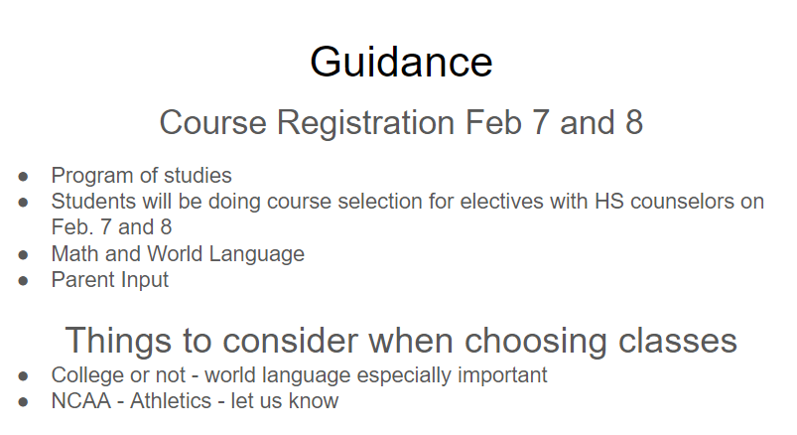

Slide 24
Athletics
Soccer
Field Hockey
Basketball
Cheerleading
Track and Field
Tennis
Cross Country
Ice Hockey
Football
Winter Track
Baseball
Softball
Golf
Bowling
Bass Fishing
Students are also allowed to participate in swimming and wrestling programs with permission from the Athletic Director.
Notes:
Athletic Director, Vicky Parady Guay

Slide 25
Clubs and Activities
Aeronautics Club
After School Fitness
Art Club
Band
Big Brother/Big Sister
Card Club
Chess Club
Chorus
Drama
Diversity Club
Honor Societies
Key Club
Leo Club
Life of a Student
Literary Arts Magazine
Math Team
Open Mic
Outing Club
Robotics Club
Shop Club
Student Council
Students with a Voice
Ultimate Frisbee
Yearbook
Have an idea for a new club? Talk to us!!!
Notes:
Amanda (McVey) & Chloe (Cina)

Slide 26
Final Thoughts
Our goal is to make your child’s high school experience challenging, meaningful, and most importantly, enjoyable.
We look forward to working with you over the next four years to make this happen!!!
642-3341 ext. 105

Slide 27
Where To?
A-F: ROOM 201
G-K: ROOM 205
L-R: ROOM 207
S-Z: ROOM 208

